Slide 1
3
Marketing Environment

Slide 2
Do Now
Outbox – Unit 2 NEW UNIT!
Find “Exercise – SWOT Day 1” in teacher outbox.
Complete Part 1 – your career goal.

Slide 3
Grades
Monday review of:
Test
McD’s Exercise
Charity Presentation

Slide 4
Today’s Objectives
Learn parts of a SWOT analysis
Learn how it is used
Apply SWOT to a personal goal.

Slide 5
Get Ready to Take Notes

Slide 6
SWOT
Strengths
Weaknesses
Opportunities
Threats
Provides a way to analyze your business and its environment.

Slide 7
SWOT Structure
Internal | External
Strengths Weaknesses You, the company can control Strengths & Weaknesses Example: Apples' technology | Opportunities Threats Environment outside the company. Can’t control. Example: Samsung’s competitive threat.

Slide 8
Strengths
Internal capabilities that help a company reach its objectives.
Example: Apples' technology

Slide 9
Weaknesses
Internal limitations that interfere with a company reaching its objectives.
Example: McD’s reputation for high calorie, unhealthy food.

Slide 10
Opportunities
External factors that a company can exploit to achieve its objectives.
Example: Increasing consumer demand for smart phones in developing countries like China.

Slide 11
Threats
External factors that challenge a company’s performance.
Example: Competition - Samsung’s large screen smart phones.

Slide 12
Individual Think Time
Add two more examples to each SWOT box.
It will help to think of a company – e.g. McDonalds
Sample format for a Strength:
Technology – Apple software/hardware.

Slide 13
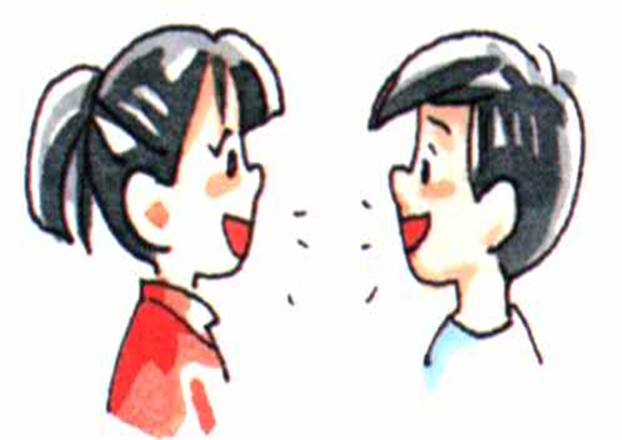
Pair / Share
Present your ideas to your desk partner
Add one of your partner’s ideas to each box.

Slide 14
Compare Notes
Share SWOT ideas.

Slide 15
Strengths
Internal capabilities that help a company reach its objectives.
Brand, reputation
Unique product
Technology
Customer service

Slide 16
Weaknesses
Internal limitations that interfere with a company reaching its objectives.
Poor reputation
Poor products
Obsolete technology
Poor customer service
Basically, many strengths can be weaknesses if the firm does a poor job.

Slide 17
Opportunities
External factors that a company can exploit to achieve its objectives.
Market growth
New technologies, innovations
Weak competitors

Slide 18
Threats
External factors that challenge a company’s performance.
Strong competitors
Technological changes
Poor economy
Government regulation

Slide 19
Career SWOT – Stock trader
SWOT
S: high interest in stock market
W: no work experience
O: older traders retiring
T: very competitive

Slide 20
Career SWOT
Go to “Exercise – SWOT Day 1”
Complete Part 2 – your personal SWOT on your career goal.
Identify two strengths, weaknesses, opportunities and threats.

Slide 21
Pair / Share
Present to your elbow partner
Partner – find two good points.
Partner – make two suggestions.

Slide 22
Action Plan – Stock Trader
Action Plan
Strength | Build by reading CNBC every day.
Weakness | Correct by getting an internship job.
Opportunity | Exploit by getting to know people in the business.
Threats | Counter job competition by looking at smaller firms.

Slide 23
Action Plan
Go to “Exercise – SWOT Day 1”
Complete Part 3 – develop a personal action plan to:
Build on your strengths
Correct your weaknesses
Exploit opportunities
Counter threats

Slide 24
Summary
SWOT helps us analyze our environment.
It helps us determine whether we can achieve our goals, and what will help or hinder us from getting there.
By identifying strengths, weaknesses, opportunities and threats, we can build an action plan to get us to our goal.

Slide 25
Applying SWOT
Socrative.com Room: b755cc0e
Login with last name, then first
SWOT Exit Ticket
Consider one of the company’s that we’ve studied.
Identify one strength, weakness, opportunity and threat for that company.

