Slide 1


Forces page 41 on your notebook

Slide 2
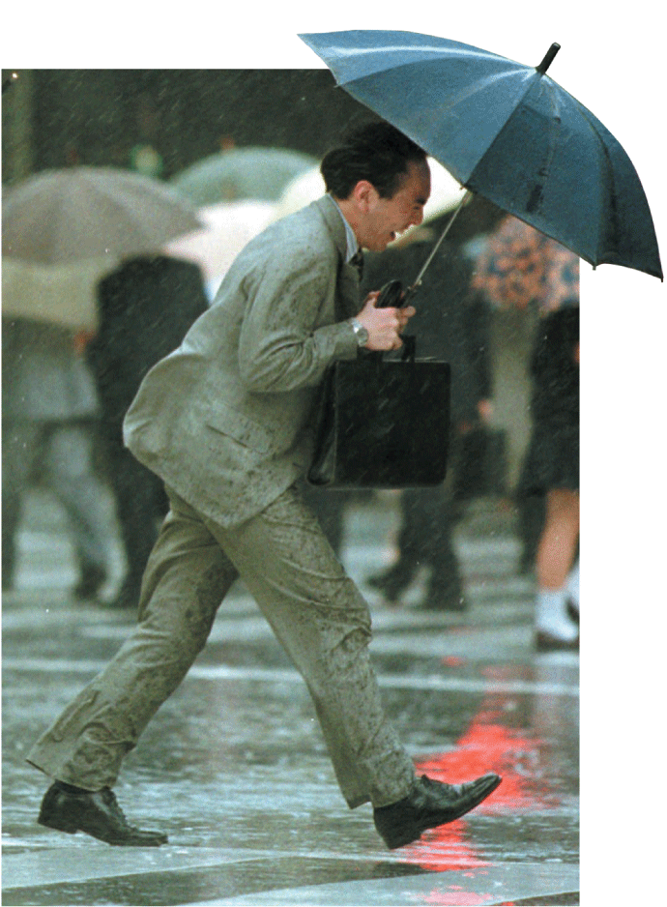
Page 40
Describe what is happening in this picture?
The wind pushes against the man and his umbrella. The push from the wind is a force.
Thinking back to your Marshmallow challenge, what forces were acting on it?

Slide 3
How do forces affect the motion of an object?
First we need to define the word FORCE:
A force is a push or a pull that acts on an object.
Two types of forces
  Pushes
  Pulls

Slide 4
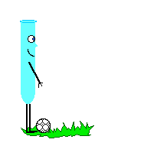
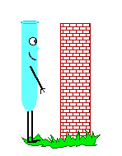
A force can cause motion:
accelerating a moving object by:
    changing the object’s speed
    Changing the object’s direction.
cause a resting object to move
  It is a vector quantity.
    Direction is important!!

Slide 5
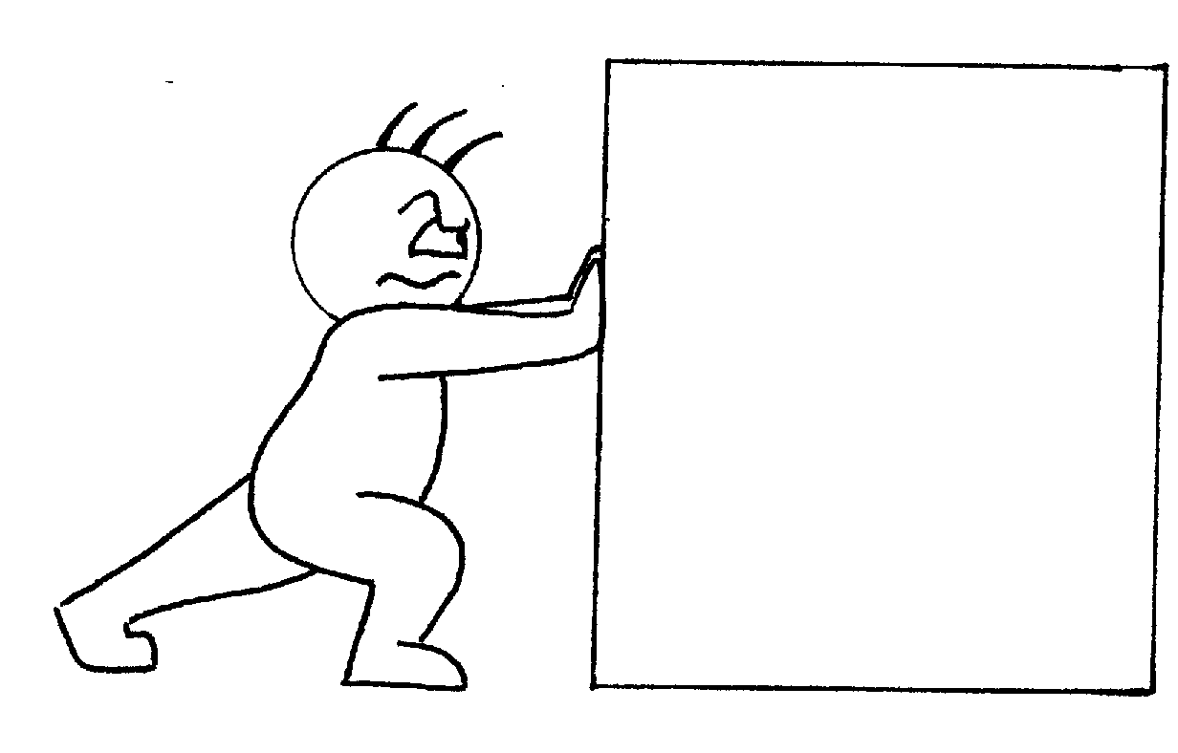
What is force?
A force is a push or a pull
It can change the movement of an object
Sometimes forces are obvious, but not always. Do you notice the force of the floor on your feet pushing you up?
Can you feel the force of the atmosphere pushing at your body?

Slide 6
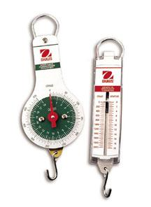
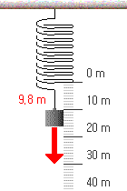
Forces are measured in
Newtons
SI unit of force
Symbol: N
Measured by using a spring scale
Units of Force
One newton (N) is the force that causes a 1-kilogram mass to accelerate at a rate of 1 meter per second each second (1 m/s²).
1 N = 1 kg•m/s²

Slide 7
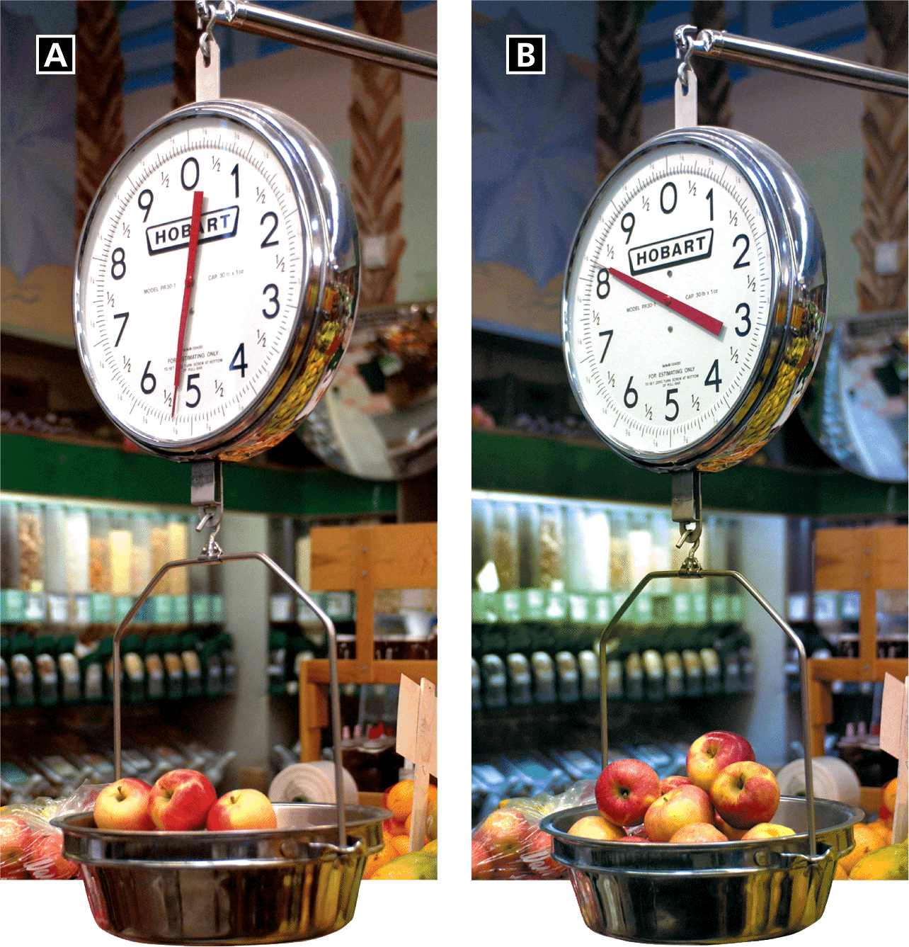
What Is a Force?
Measuring Force
You may have measured forces using a spring scale. The stretch of the spring in the scale depends on the amount of weight (a type of force) acting on it.

Slide 8
Forces are represented by using ARROWS.
The directions of the arrows represent the direction of the FORCE. While the length of the represents: THE AMOUNT OF FORCE (WEIGHT/MASS).

Slide 9
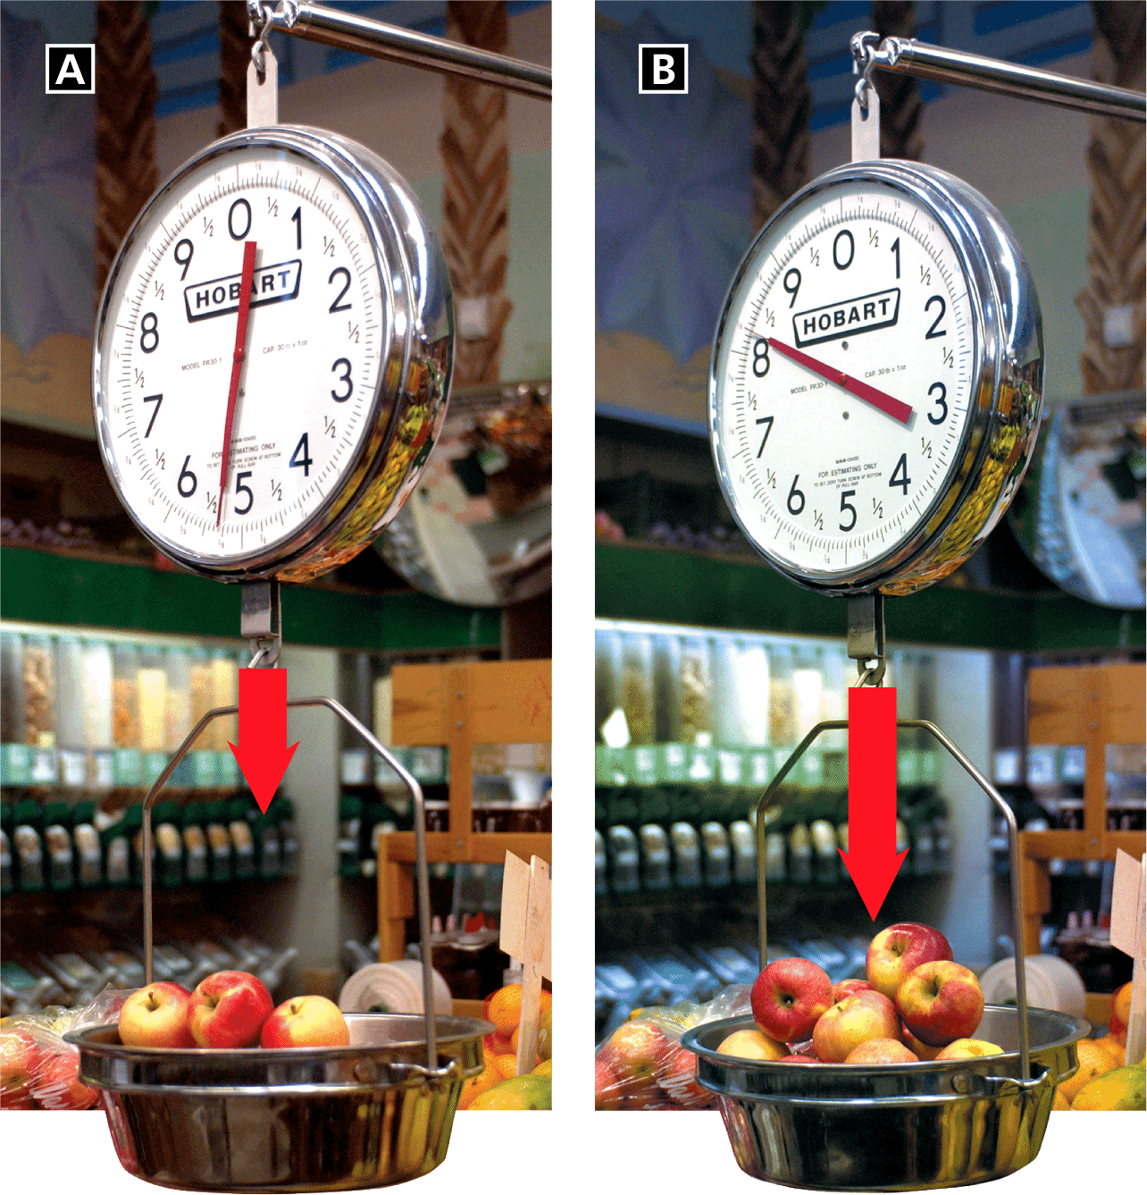
What Is a Force?
Representing Force
Arrows can represent a force. The lengths of the arrows show relative amounts of force.

Slide 10
Exit Pass #1 11/17/15 – Write this pass on your notebook
Look carefully at Figures 2, 3, and 5 in your textbook. Then complete the table by describing the forces and motion shown in each figure
Forces and Motion
Figure | Is Net Force 0? | Effect on Motion
2A | Yes | None
2B | Yes | No Motion
3 | Yes | No Motion
5A | yes | No Motion
5B | No | Plant accelerates

Slide 11
Spring Scale Activity
You will be using page 42 of your notebook for this activity.
Object | Force (N)

Slide 12
Spring Scale Activity
Draw the arrows so that they represent the strength of the force.
Use the following scale to draw your arrows:
    1 cm = 1 N
    1 cm = x boxes (Using the graph paper, measure how many ‘boxes’ are in 1cm)

Slide 13
C4U #1 – Page 40
The SI unit for force is 1 kg•m/s², also called one kepler.
True
False
ANS: F, newton

Slide 14
Page 44 of notebook
DO NOW: 11/23
What do force arrows tell us?
The directions of the arrows represent the direction of the FORCE. While the length of the represents: THE AMOUNT OF FORCE (WEIGHT/MASS

Slide 15
Balanced Forces

Slide 16
Combining Forces
Have you ever helped to push a car that has run out of gas?
you were taking advantage of the fact that forces can be combined.
The individual force of each person’s push adds with the others into a larger force that allows you to move the car.

Slide 17
Combining Forces
Combining force arrows to show the result of how forces combine
+
ADD
forces in the same direction add together
+
SUBTRACT
forces in opposite directions subtract from one another.
Just Like Displacement!

Slide 18
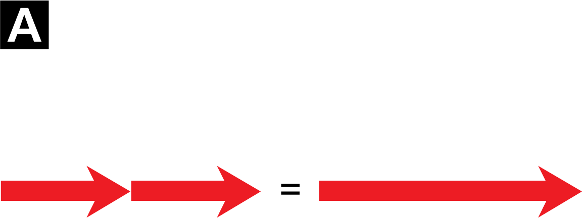
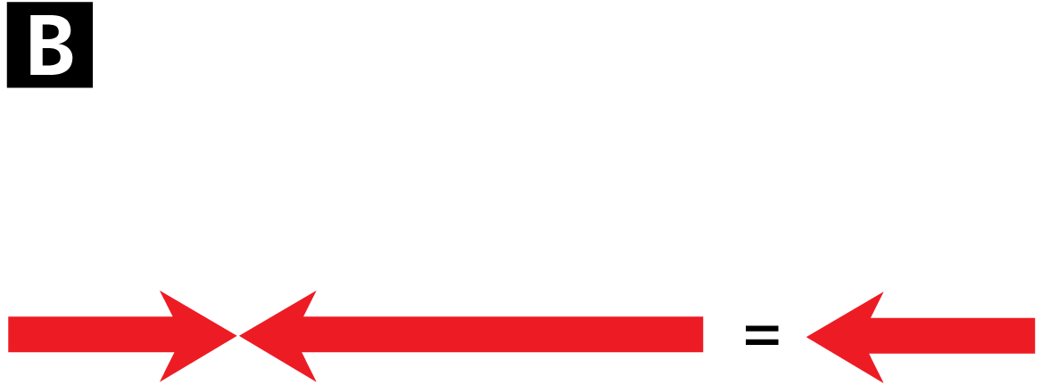
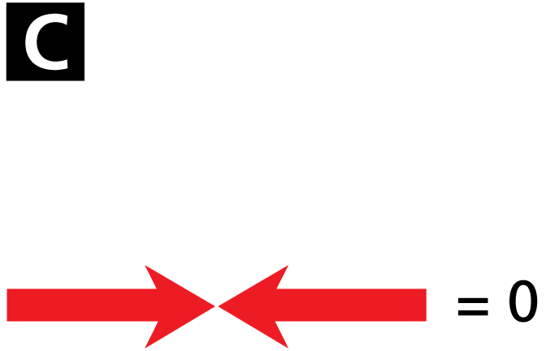
Combining Forces
Forces can add together or subtract from one another.
Adding forces
Subtracting forces
Equal and opposite forces

Slide 19
Combining forces are called
NET FORCES
The net force is the overall force acting on an object after all the forces are combined.
Net force = the combined forces acting on an object

Slide 20
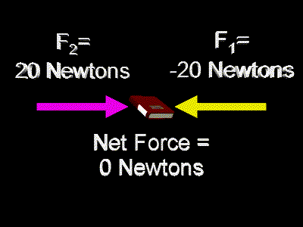
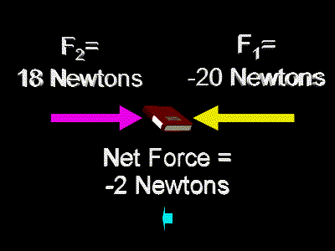
Net Force (F_{net})
Sum of all forces acting on an object.
If there is a net force acting on an object, the velocity of the object will change!!

Slide 21
C4U #2
What would be the effect on the direction of the net force if some of the people push the car forward while others push it back- wards?
The net force would be in the direction of the people who were pushing with a greater force.

Slide 22
Forces may be :
balanced
unbalanced
one or more forces acting on
an object are stronger than others
all forces acting on
an object are equal
There is MOTION
  There is NO MOTION
forces that are not equal in magnitude and opposite in direction!
forces that are equal in magnitude, but opposite in direction!!

Slide 23
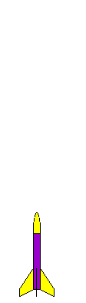
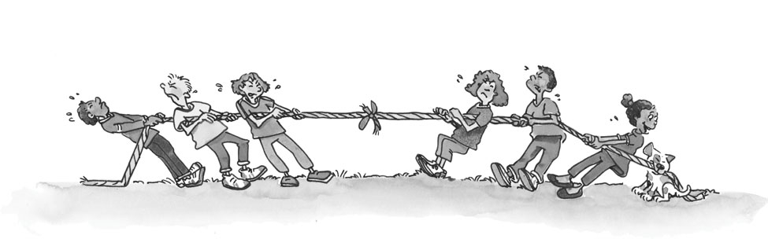
Balanced vs. Unbalanced Forces
  Will not cause a change in the motion of the object!!
  Will cause a change in the motion of the object!!
Unbalanced
Balanced
An unlimited number of individual forces can act on an object to produce a net force of zero.

Slide 24
C4U # 3
True or False
When the forces on an object are balanced, the net force is zero, and there is no change in the object’s motion.
True

Slide 25
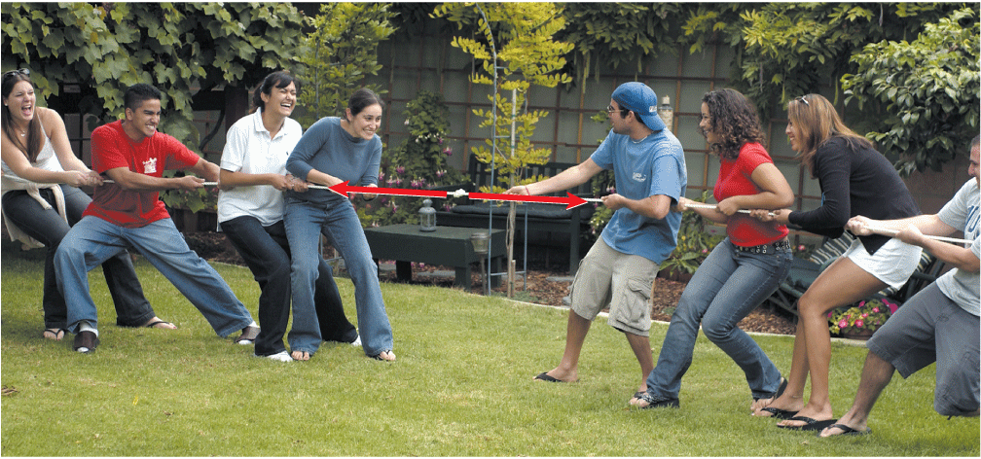
Balanced Forces
The two groups pull with equal forces in opposite directions. The forces combine to make a net force of zero.

Slide 26
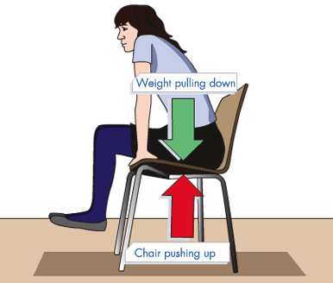
Balanced Forces = forces that are equal in size and in opposite directions (no movement occurs)

Slide 27
C4U # 3
True or False
When an unbalanced force acts on an object, the object accelerates.
True

Slide 28
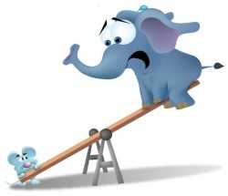
Unbalanced Forces
An unbalanced force is a force that results when the net force acting on an object is not equal to zero.
Unbalanced = the two forces are not equal, so that there is a movement in one direction.

Slide 29
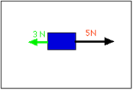
Free Body/ FORCE Diagrams
A free-body diagram is a sketch of an object that showes all of the forces acting on it.

Slide 30
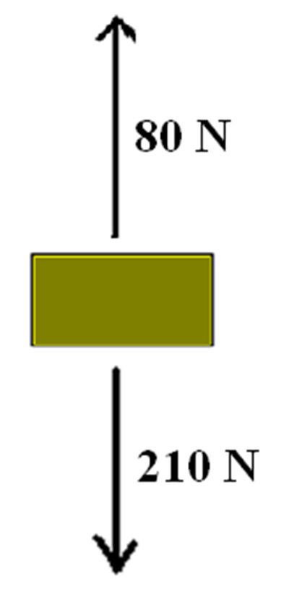
DO NOW 11/24
1. draw a picture to represent unbalanced forces
2. draw a picture to represent balanced forces
3. Balanced or Unbalanced?
Find the F_{net}

Slide 31
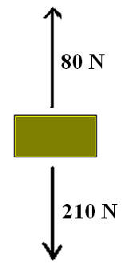
Balanced or Unbalanced?
Find the Net Force
Unbalanced
F_{Net} = 130 N down

Slide 32
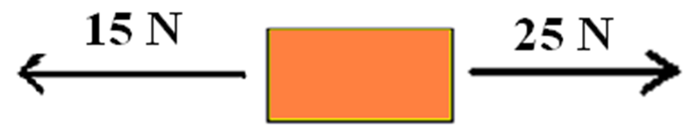
DO NOW 11/24
3. Balanced or Unbalanced?
Find the F_{net}
1. draw a picture to represent unbalanced forces
2. draw a picture to represent balanced forces

Slide 33

Balanced or Unbalanced?
Find the Net Force
Unbalanced
F_{Net} = 10 N Right

Slide 34
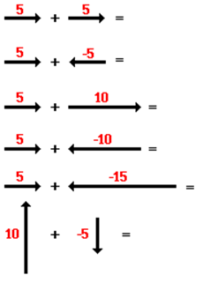
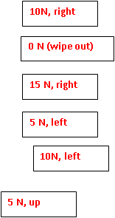
HW

Slide 35
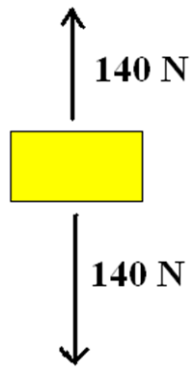



Are the forces Balanced or Unbalanced?
Balanced
Balanced
Unbalanced
Unbalanced

Slide 36
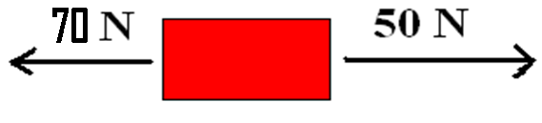
Balanced or Unbalanced:
Balanced
Unbalanced

Slide 37
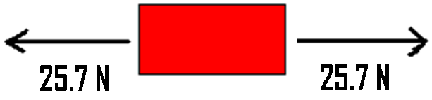
Balanced or Unbalanced:
Balanced
Unbalanced

Slide 38
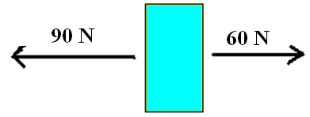
Balanced or Unbalanced?
Find the Net Force
Unbalanced
F_{Net} = 30 N left

Slide 39

Balanced or Unbalanced?
Find the Net Force
Balanced
F_{Net} = 0 N

Slide 40
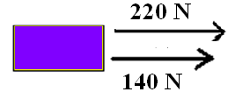
Balanced or Unbalanced?
Find the Net Force
unbalanced
F_{Net} = 360 N right

Slide 41
How is the net force determined when two forces act in the same direction on an object?
The forces are Subtracted. The direction is the same as the forces
The forces are added. The direction is opposite as the forces
The forces are added. The direction is the same as the forces

Slide 42
Find the Net force in the diagram below:
120 N right
120 N left
20 N right
20 N left

Slide 43
When two arrows directly oppose one another and are different in size, what will be the direction of the net force?
The direction of the net force will be the same as the direction of the longer arrow.
B. The direction of the net force will be opposite the direction of the longer arrow.

Slide 44
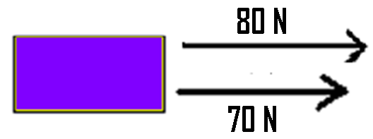
Determine the Net Force:
10 N right
150 N right
160 N right
150 N left

Slide 45
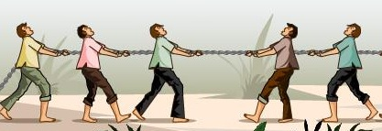
CFU #4
Examine this tug of war. Each person can pull with exactly (1N) force.
3N
What is the force for the team on the left side? ____
What is the force for the team on the right side? ____
What is the net force acting on the rope? _____
2N
1N

Slide 46
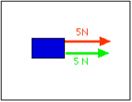
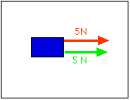

Forces in the same direction mean that the object will move in the direction that BOTH forces are moving.
What is the F_{ne}t?
10N right
When your forces are going in the same direction, the net force will be the sum of the forces.
10N right

Slide 47
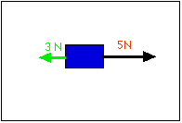
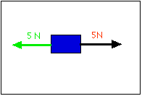
Forces in different directions mean that the object will move in the direction that the LARGER force is moving.
When your forces are going in different directions, the net force will be the difference between the forces.
2N East or Right
2N East or right
When your forces equal each other, the object will not move
0 N

Slide 48
Remember:
Quiz on Tuesday:
EDP Vocab - focus on the terms used in the design challenge/design process
EDP- engineering design process
Forces
  Balanced
  Unbalanced
  Net forces
  Vocabulary for section 12.1

