Slide 1
If you were the most powerful person in the country, what would you do?

Slide 2
Absolute Monarchs of Europe
Modern World History Patterns of Interaction
Chapter 5
Pg 130 - 160
1

Slide 3
Essential Question
How does a society evolve and change?
How does this question relate to absolutism?
How did society/government evolve into absolutist monarchies?
How does the rise of absolutism spur future change and revolution?

Slide 4
Absolutism!
What is absolutism?
Absolute monarch holds all the power
Divine Right - God has chosen the absolute monarch to rule. The monarch only reports to God, not his/her subjects
Why now?
Renaissance - growth in cities
Reformation - decrease of Catholic church power
Exploration - increase in wealth
3
3

Slide 5
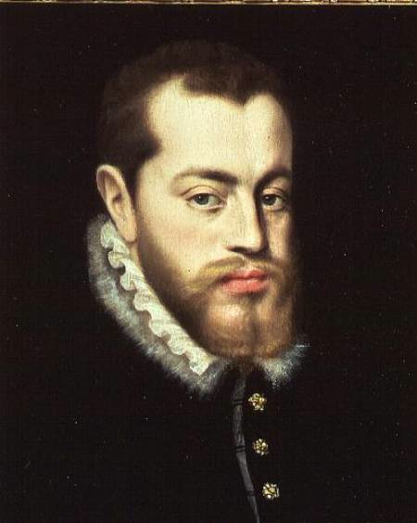
Phillip II of Spain (pg 133-135)
4
4

Slide 6
Philip II (1556-1598)
Spanish
Early Life
Took power after father Charles V divided his empire into 5 parts and retired to a monastery.
Inherited Spain, Spanish Netherlands, and the Central and South American Colonies.
Philip was considered shy, serious, and deeply religious..”
5

Slide 7
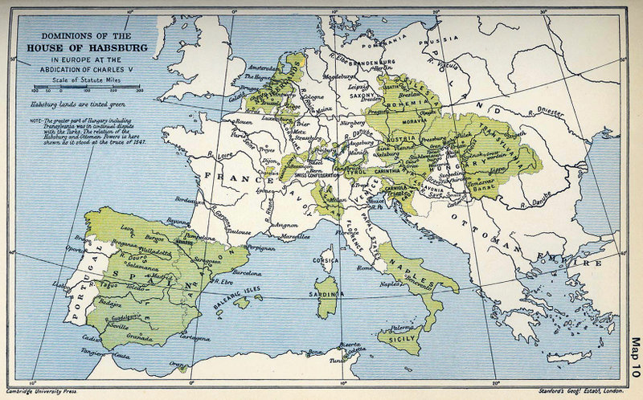
6
6

Slide 8
Philip’s Empire
Achievements:
Defender of the Faith
Philip II tried to defend Catholicism from Protestants and Muslims
Spanish Armada
Thanks to the Central and South American Colonies, Spain and Philip II were becoming very rich.
More money -> more power for Philip
Golden Age of Spanish Art and Literature
El Greco - artist
Don Quixote by Cervantes
7

Slide 9
How much money did Spain take from the Americas?
Gold @ $1,726/ounce today
Silver @ $33/ounce
16,000 tons of silver
Convert tons to oz: 16,000 X 2,000 X 16
512,000,000 oz X $33 =
$16,896,000,000
339,000 lb of gold
Convert lbs to oz: 339,000 X 16
5,424,000 oz X $1,726 = $9,361,824,000
Total: $27,157,824,000
8

Slide 10
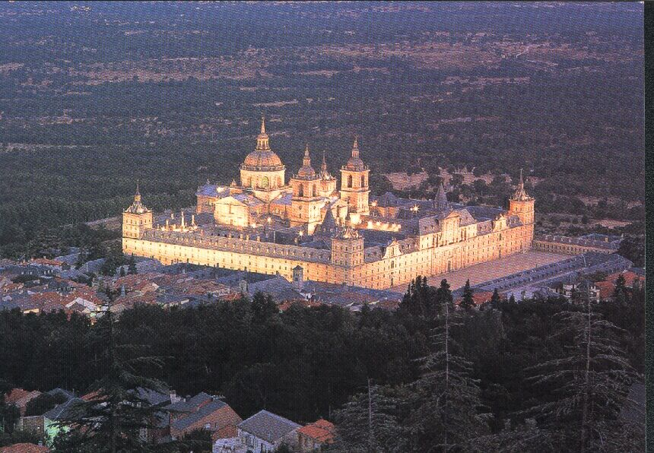
The Escorial, Philip II’s Palace
El Escorial
9

Slide 11
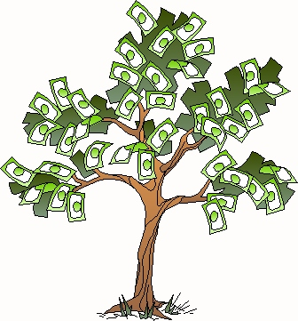
Phillip II
Legacy/Downfall:
Economic Problems
Expensive religious battles
Inflation from all of that free money from the Central and South American Colonies
Nobles were not taxed - all the burden lay on lower classes -> did not develop a middle class to spur business
Multiple Bankruptcies
Que Lastima!!!
10

Slide 12
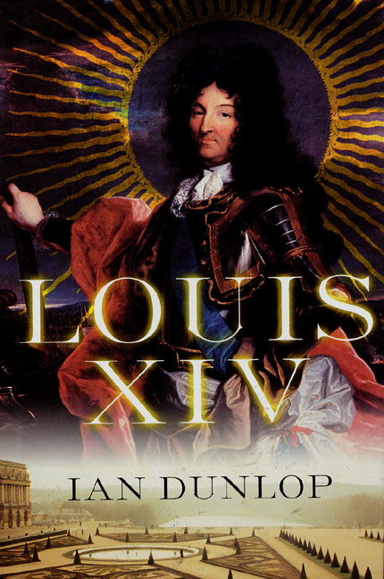
11
11

Slide 13
King Louis XIV (1638-1715)
pg 139- 143
French
Early Life
His reign, from 1643 to his death in 1715 was the longest documented reign of any European monarch.
Cardinal Mazarin helped Louis rule when he was young
Louis XIV distrusted nobility as they tried to take his power when he was young - wanted to be so powerful, no one could threaten him!
Known as the “Sun King”
“L’etat c’est moi” - I am the state
12

Slide 14
Louis XIV
Achievements
Economic Growth
Louis XIV minister - Colbert- helped to strengthen the economy
France began to focus on Mercantilism- expanded manufacturing, became self sufficient, developed favorable balance of trade
Cultural Growth
Built Versailles - Grand Palace - Monument to glory of Louis XIV and absolutism
Patronage of the arts - > purpose was not to glorify god (like in middle ages) or human potential (Renaissance) but to glorify the king (himself)
14
14

Slide 15
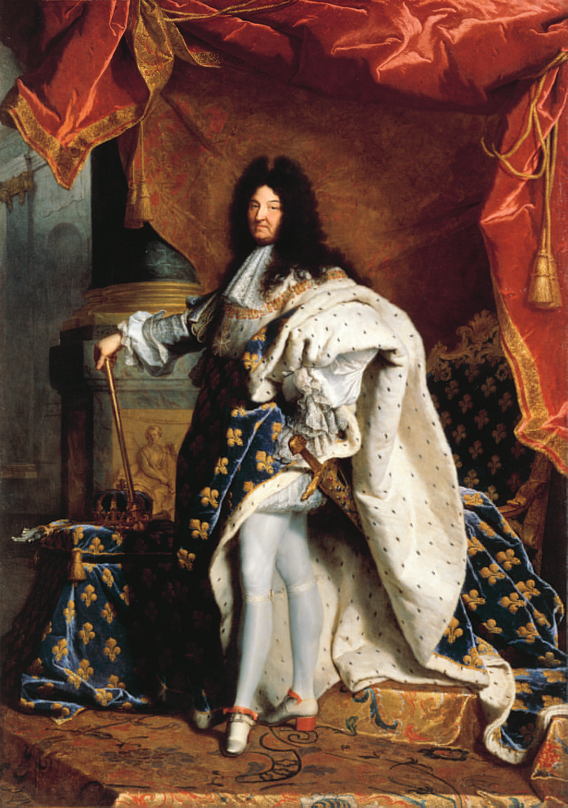
Louis spent a fortune to surround himself with luxury.
Every meal was a feast
One observer reported that once devoured four plates of soup, a whole pheasant, a partridge in garlic sauce, two slices of ham, a salad, a plate of pastries, fruit, and hard-boiled eggs in a single sitting!
Nearly 500 cooks, waiters, and other servants worked to satisfy his needs.
There was not enough water pressure to run all the fountains at once.
So, a servant would run ahead of Louis, turn on the fountain just before Louis would see it, then turn it off after he had walked past.
FOR EXTRA INFO....
15

Slide 16
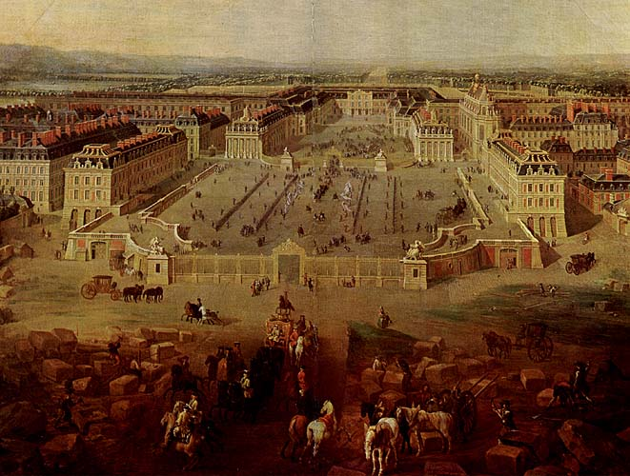
The Palace at Versailles
Cost: estimated $2 billion
Main building: 500 yards long
2,000 rooms
15,000 acres of gardens
1,400 fountains
Labor force:
36,000 laborers
6,000 horses
17

Slide 17
Why all the attention?
Appealed to Louis’ arrogance However, there was an alternative reason that Louis required his nobles to wait on him daily.
Feudal times = powerful/free nobles
By making the nobles stay at Versailles, they no longer had free time to govern.
They lost control of their subjects and, thus, lost their power.
That power over the citizens now belonged to King Louis.
In this sly way, Louis did limit the powers of the nobles, all without a fight!!!
19

Slide 18
Louis: Smart guy, bad decisions - His legacy/downfall
`
Frequent wars (ex. War of Spanish Succession, massive taxation, and a series of poor harvests brought great suffering to the French people.
Despite the success of his finance minister, Louis XIV’s spending put the country in debt
When he died in 1715, the people of France rejoiced.
France was a world power - but at what cost?
20

Slide 19
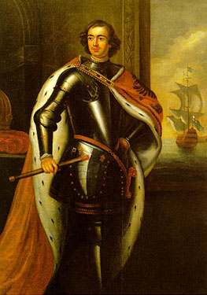
Peter the Great (1672-1725) pg 149
22
22

Slide 20
Peter the Great
Russian
Early Life/Background
Part of the Romanov family
Russia was separated from Western Europe by...
Religion - Eastern Orthodox
Geography - Mongols and cold water port had cut off Russia from western Europe
Came to be known as Peter the Great because he was one of Russia’s greatest leaders and reformers and he was a big man, over 6’6” tall!!!
23

Slide 21
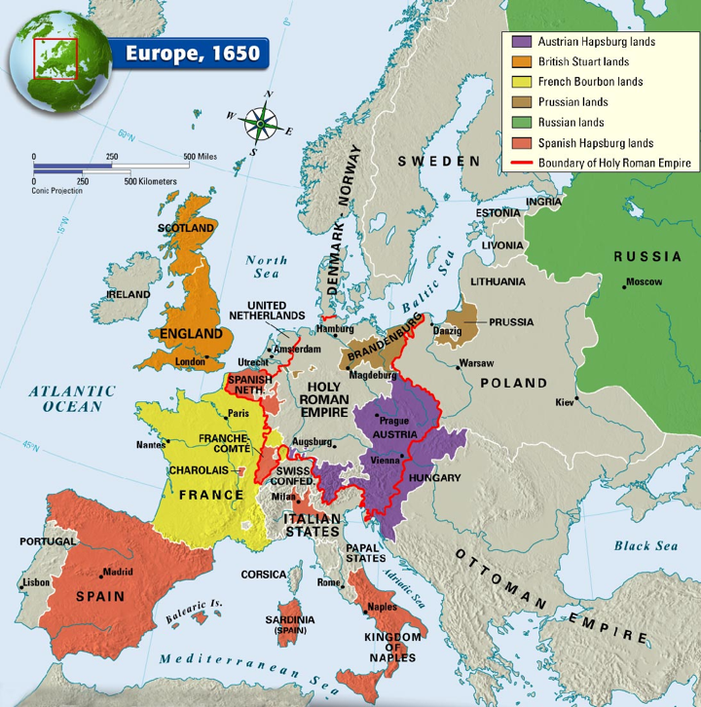

Slide 22
Peter visits the West - Early Life
In 1683, 1 year after becoming czar, he embarked on the “Grand Embassy”, a long visit to Western Europe to learn more about Western Europe’s customs and industrial techniques.
On his journey, he insisted on keeping his identity secret and dress in plain clothes
.. But he traveled with 200 servants and 55 boyars...
...Not so “secret”
24

Slide 23
Peter’s Reforms - Achievements
Peter was determined to Westernize Russia so it could compete with other European countries.
He knew that many people would refuse, so he increased his power as an absolute ruler.
He:
Brought the Russian Orthodox Church under state control
Reduced power of the wealthy landowners.
Increased power of lower-ranking families that promised loyalty.
These men and women pledged their lives to Peter.
Hired European military offices to drill his soldiers in new ways
25

Slide 24
Achievements - Westernizing Russia
In order to make Russia more like Western Europe, he:
Introduced potatoes, which would later become the staple food of Russia.
Raised women’s status
Ordered nobles to give up their traditional clothes for Western European fashions.
Build a new capital with a warm water port- St. Petersburg - so that he could easily access Western Europe
26

Slide 25
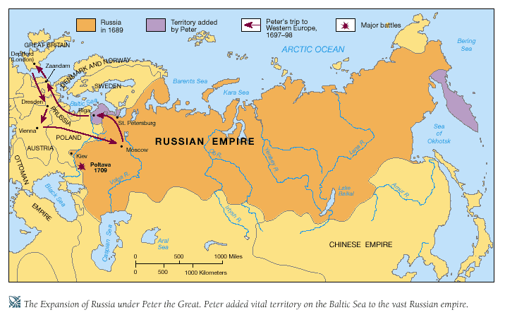

Slide 26
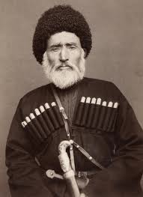
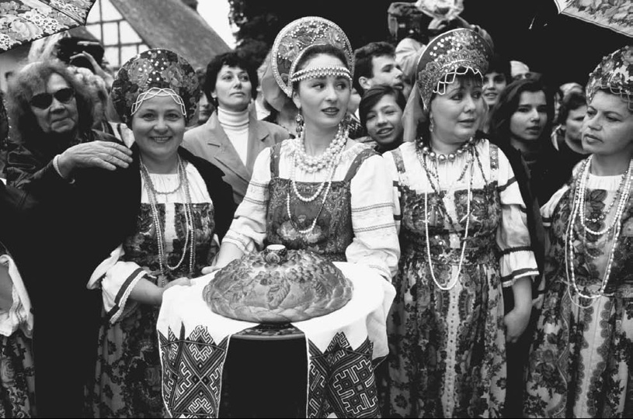
27
27

Slide 27
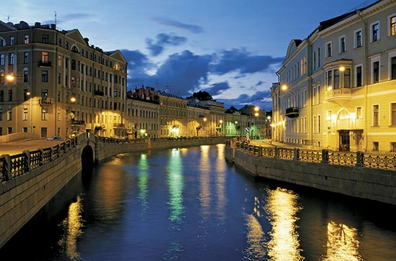
A New Capital - St. Petersburg
Peter believed Russia’s future depended on having a warm-water seaport.
To promote education and growth, Peter wanted a seaport that would make it easier to travel to the West.
He began building the new capital on the swampy, unhealthy lands close to the Baltic Sea.
An estimated 25,000 to 100,000 died from disease and poor working conditions while building St. Petersburg, which is named after Peter’s patron saint.
When it was finished, he ordered many of the Russian nobles to leave the comforts of Moscow and relocate to St. Petersburg.
28
Notes:
Peter believed Russia’s future depended on having a warm-water seaport.
To promote education and growth, Peter wanted a seaport that would make it easier to travel to the West.
He began building the new capital on the swampy, unhealthy lands close to the Baltic Sea.
An estimated 25,000 to 100,000 died from disease and poor working conditions while building St. Petersburg, which is named after Peter’s patron saint. When it was finished, he ordered many of the Russian nobles to leave the comforts of Moscow and relocate to St. Petersburg.

Slide 28
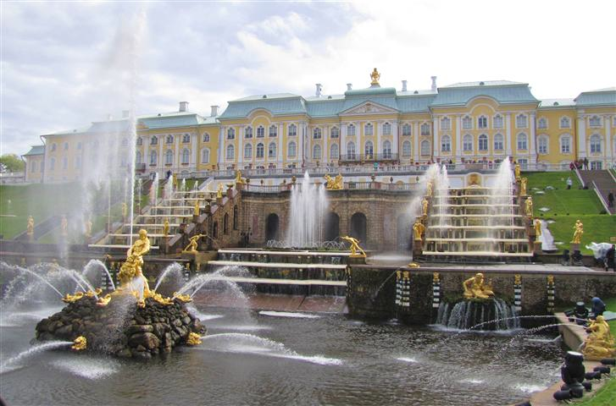
29
29

Slide 29
Peter the Great
Legacy
Despite its importance for access to western Europe, 25,000 to 100,000 people died while building St. Petersburg
He advanced Russia as a European power
Diminished authentic Russian culture - in attempts to westernize, he forbid many traditional Russian forms of dress and culture because they were viewed as “backward”
30
30

Slide 30
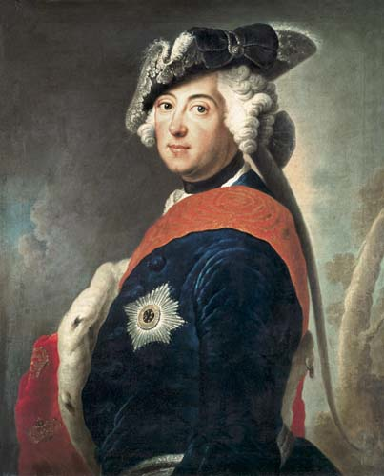
Frederick the Great (1712-1786)
pg 151 -
155
31
31

Slide 31
Frederick II (“the Great”)
Prussia
Early Life/Background
After 30 years war - his father Frederick William decides to built up army and create absolute monarchy for protection
Frederick William got nobles to agree by making them officers
Frederick William worried about his son’s strength - forced him to watch a friend’s beheading
32
32

Slide 32
Frederick II
Achievements
Continued to build the Prussian military
Prussia became a military power
Fatherly figure to his people
Legacy
Embroiled Prussia in constant wars over territory
War of Austrian Succession
Seven Years War
33
33

Slide 33
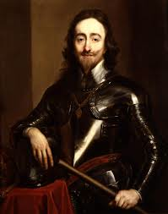
Charles I (1600 - 1649)
pgs 156 - 159 in book

Slide 34
Charles I - Early Life
In 1625, Charles I takes over from his father James
James I fought many expensive wars
Inherited struggles between father and parliament over money and reforms

Slide 35
Charles I - Achievements
Signed the Petition of Right in 1628 - agreement between himself and Parliament to get funds for wars
Said that Charles I....
Would not imprison subjects without due cause
Would not levy taxes without Parliament’s consent
Would not house soldiers in private homes
Would not impose martial law in peacetime
But.....Charles ignored this

Slide 36
Charles I - Legacy
The struggles between King and Parliament led to the ENGLISH CIVIL WAR (1642-1649)
Royalists/Cavaliers = those who remained loyal to Charles I
Roundheads = Puritans who supported Parliament
Bloody war ending with Puritans and Oliver Cromwell taking power as well as execution of Charles I
Although in 1659 - Charles II (Charles I older son) is restored to the throne during the Restoration

