Slide 1
Vegetarian and Vegan Diets

Slide 2
What is a Vegetarian diet?
There are four types of vegetarian diets:
  Vegan or total vegetarian- diet includes only foods from plants: fruits, vegetables, legumes (dried beans and peas), grains, seeds and nuts
  Lacto vegetarian- diet includes plant foods and dairy foods
  Ovo-lactovegetarian- diet includes foods from plants, dairy and eggs
  Semi-vegetarians- diet does not include red meat but include chicken and fish with plant foods, dairy products and eggs

Slide 3
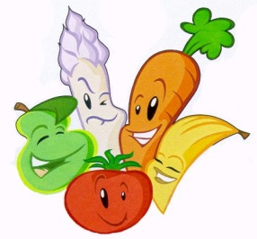
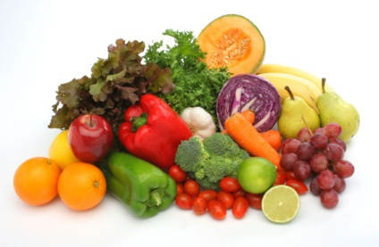
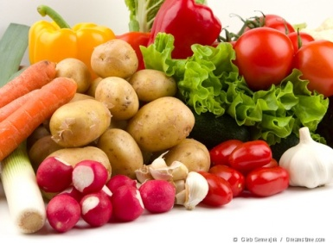
Are vegetarian diets healthy?
Vegetarian diets can be healthy if they’re carefully planned to include essential nutrients
Many studies have shown that vegetarians seem to have a lower risk of obesity, heart attacks, high blood pressure, diabetes mellitus and some forms of cancer

Slide 4
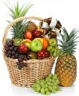

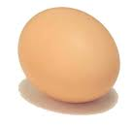
Why do people become Vegetarians?
They have serious ethical problems eating meat.
Dietary reasons- They believe it’s very high in cholesterol.
Slaughtering chickens and other animals seem unacceptable to vegetarians.
They complain consumption of meat causes farmers to deforest land, so they have more room for their cattle.

Slide 5
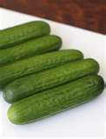
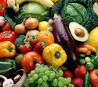
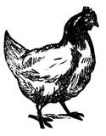
Why do people become Vegans?
Animal rights is one reason people become vegan.
Many people have been able to lose a lot of weight by becoming vegan.
People with diabetes are able to eliminate or control their diabetes by becoming vegan.
By becoming vegan you are lowering the demand for livestock which protects animal rights.

Slide 6
What are Vegans?
Vegans, are basically vegetarians, except they don’t use anything from animals. For example, they don’t eat any sort of meat, beef, or poultry. They don’t use any other animal products such as wool, fur, and all other things from animals.
People become vegans for different reasons. Some people do it, because it is healthy. Other’s do it for environmental, or ethical reasons. People think that it will make a more peaceful and humane world.

Slide 7

What foods could/should a vegan eat?
While vegans don’t eat any animal products, they do eat a wide variety of foods to make up for the nutrients they don’t get from the foods they don’t eat. Some examples are oatmeal, cereal, and orange juice.
Some suggested foods vegans should eat when going out, are Chinese moo shu vegetables, pizza without cheese, and lentil stew.

Slide 8
Presented By:
Beatrice W.
Marvin M.
Thalia M.
Period 3

