Slide 1
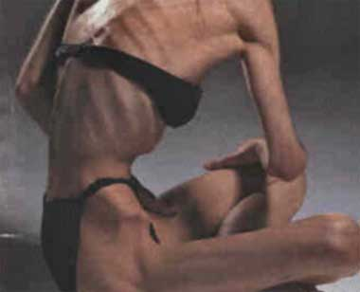
Eating Disorders

Slide 2
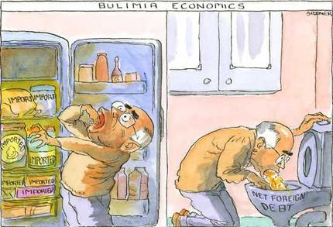
Bulimia Nervosa
Bulimia is a disorder in which people eat a large quantity of food, and then purge themselves by self-induced vomiting or laxatives.
Bulimics purge themselves because they feel they should blame themselves for an event that happened.

Slide 3
Effects of Bulimia Nervosa
Dehydration
Enlarged Salivary Glands
Electrolyte Imbalance
Inflammation of the Esophagus
Constipation
Eroded Tooth Enamel

Slide 4
Treatment of Bulimia Nervosa
Treatment of bulimia is common. Most commonly, psychological counseling is used to treat bulimia. In the aid of counseling, anti-depressants are used in cases of extreme bulimia.
Cognitive behavior therapy teaches many things, including:
Eating healthy, three meals per day.
Tips and tricks to help prevent relapse of bulimia.

Slide 5
Anorexia
Anorexia is an eating disorder, where people starve themselves.
People who are anorexic, suffer from severe weight loss.
Anorexics continue to think they are fat even after they have lost major weight and are skinny.
People who suffer from anorexia, have an intense fear of gaining weight.

Slide 6
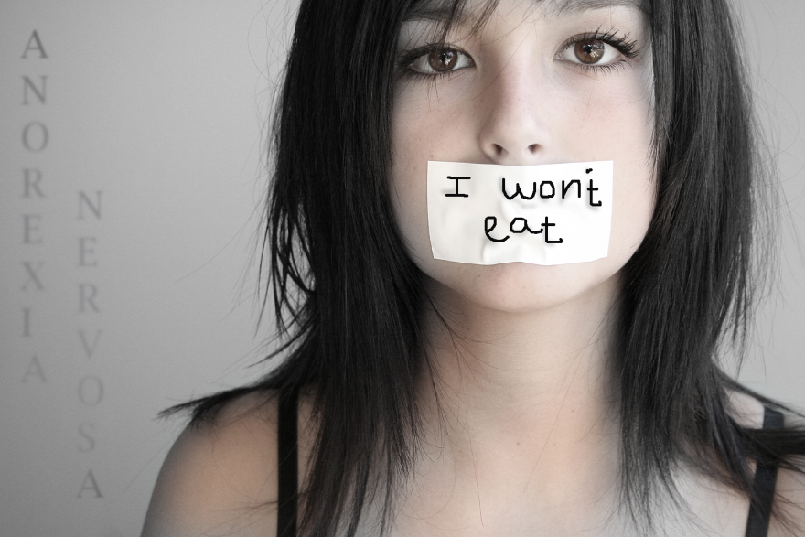
Effects of Anorexia
Is it a Diet or Anorexia?
Healthy Dieting Weight loss is viewed as a way to improve health and appearance. Self-esteem is based on more than just weight and body image. Is an attempt to control weight . The goal is to lose weight in a healthy way. | Anorexia Weight loss is viewed as a way to achieve happiness. Self-esteem is based entirely on how much you weigh and how thin you are. Is an attempt to control your life and emotions Becoming thin is all that matters; health is not a concencern.

Slide 7
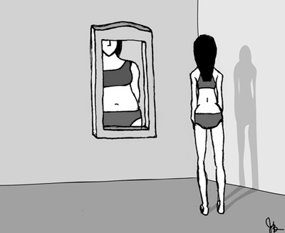
Treatment of Anorexia
Restoring the person to a healthy weight.
Treating the psychological issues related to the eating disorder.
Reducing or eliminating behaviors or thoughts that lead to disordered eating, and preventing relapse.
Visit your local doctor, to see if there is any treatment rehab groups, you may join.

Slide 8
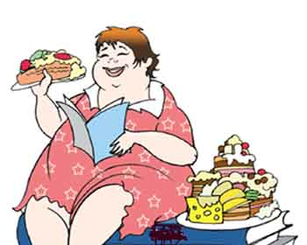
Binge Eating
Binge eating is a disorder where you eat unusually large amounts of food all the time
Symptoms
Eating large amounts of food
Eating even when your full
Eating rapidly during binge episodes
Feeling that your eating behavior is out of control
Eating a lot even when your not hungry
Depression
Anxiety
Frequent dieting, possibly without results
Frequent eating alone
Feeling depressed, disgusted or upset about your eating habits

Slide 9
Treatment for Binge Eating
Cognitive behavioral therapy- helps you better cope with issues that can trigger binge eating
Interpersonal therapy- focuses on relationships with other people that may cause binge eating
Dialectical behavior therapy- helps you learn to tolerate stress and reduce binge eating
Topamax- has been proven to reduce binge eating episodes
Meridia- anti-obesity medicine suppresses hunger

Slide 10
Credits
Matt B.
Brie K.
Peri A.
Anita U.

