Slide 1
Themes of the Unit
Economic Opportunity
Diversity and National Identity
Immigration and Migration

Slide 2
Getting started…
What inventions and technologies have made your life more enjoyable?
How have these technologies effected the economy?

Slide 3
THE MARKET REVOLUTION…
THE MAIN IDEA
Technology changes created greater interactions and more economic diversity among the regions of the nation
WHY IT MATTERS NOW
The linking of markets continues today, as technologies are opening the United States to globalized trade.

Slide 4

Capital
MONEY
MACHINERY
FACTORIES
PROPERTY

Slide 5
New Vocabulary
Capitalism- an economic system in which private individuals and corporations control the means of production and use them to earn profits
Entrepreneur- a person who organizes, operates, and assumes the risk for a business venture

Slide 6
New Vocabulary
Market Revolution- major change in the US economy when people began to buy and sell goods rather than make them for themselves
Specialization- raising one or two cash crops that you could sell at home or abroad

Slide 7
Economic Opportunity
Under capitalism, private companies and individuals controlled all aspects of production and use them to earn profits
In the 1800s many businesspeople prospered but many workers did not
There were inequities within capitalism

Slide 8
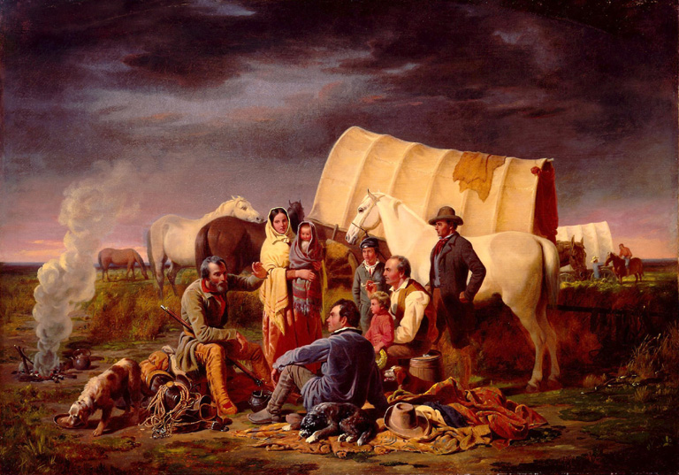
William Ranney’s 1853 Painting, Advice on the Prairie

Slide 9
Examine the painting.
Describe the scene.
Notes:
Describe the scene
What words would you use to describe the scene?
Why is the painting considered an idealistic portrayal of western settlement?

Slide 10
What words would you use to describe the scene?

Slide 11
Why is the painting considered an idealistic portrayal of western settlement?

