Slide 1
Educational Technology

Slide 2
How We Use Technology at Harrison School

Slide 4
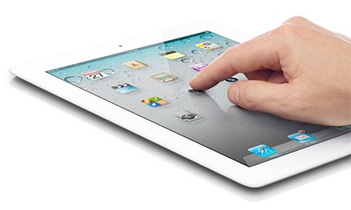
ipads:
Photo slide shows
Story creation and videos (iMovie)
Skill Practice/Lesson Reinforcement
Audiovisual assessment by teacher and self-evaluation by students
Accessing electronic and digital books (Follett Shelf)

Slide 5
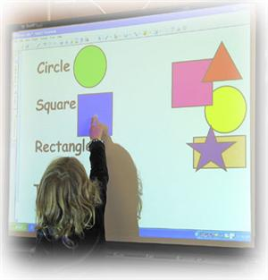
Smartboard
Interactive engagement in lessons of all content areas
New! “Splashtop”

Slide 6
Microsoft
Composing (includes text formatting), naming and saving into folders
Creating presentations: PowerPoint, Brochures (Publisher)
Inserting photos, clip art, shapes
Creating tables
Excel

Slide 7
Google (Accessible on Chromebooks and ANY computer)
Using personal log-ins
Saving and naming in Google Drive
Creating presentations (Google Slides)
Creating/completing surveys (Google Forms)
Creating Google Docs to share with teacher for comments and editing
Sharing Google Docs with writing partners
Working collaboratively in Google Docs to complete a group project

Slide 8
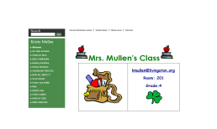
Teacher Websites
Blogging
Webquests
Accessing class notes, newsletters, and homework
Links to helpful websites and other resources
Watching videos (i.e., educreation math demos) to review concepts and skills

Slide 9
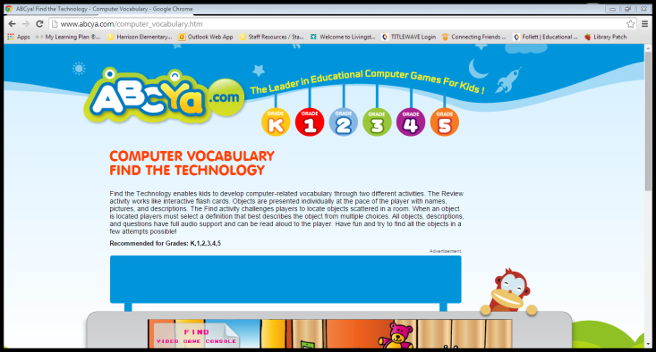
Websites
Research (including access to subscription databases and citations)
Skill practice (i.e., IXL Math, XtraMath, Raz Kids, A to Z Learning, abcya)
Creating digital presentations: Animoto, Prezi
Learning about Computer Coding
Navigating between pages

Slide 10
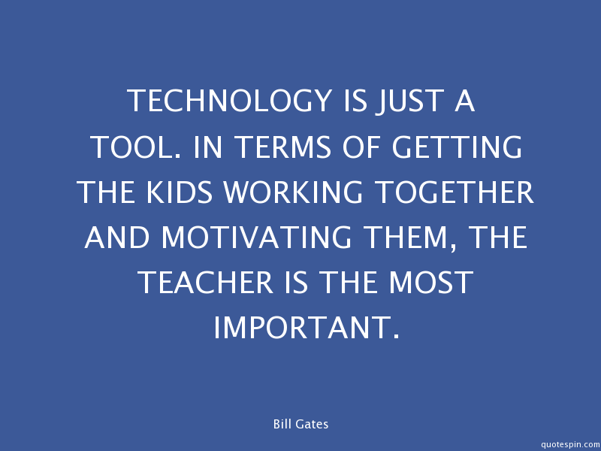
These are all helpful tools used by thoughtful instructors:

Slide 11
Now it’s time to see for yourself!

