Slide 1
THE ROMAN EMPIRE: POSITIVE OR NEGATIVE?
Did each person, event, or term help or hurt Rome?

Slide 2
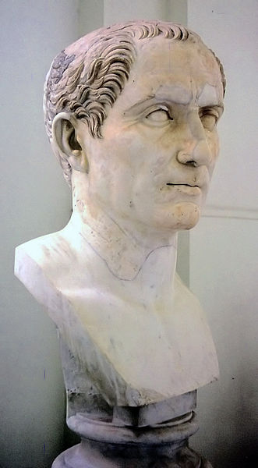
JULIUS CAESAR
Directly led to end of the Roman Republic and beginnings of the Roman Empire
One of history’s greatest conquerors
Led Rome as a dictator for a short time

Slide 3
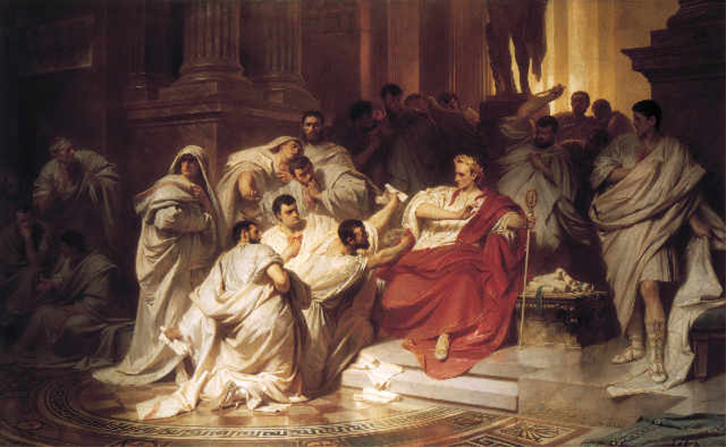
ASSASSINATION OF CAESAR
Caesar is attacked on the Senate floor and stabbed to death
Led to a series of civil wars

Slide 4
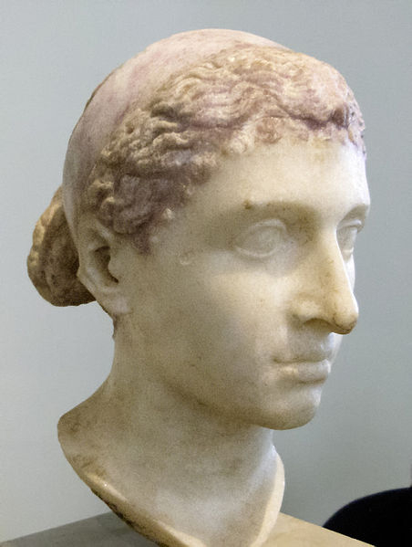
WAR BETWEEN AUGUSTUS AND MARK ANTONY
After Caesar’s death, the two men fight for control of Rome in a series of civil wars
Augustus is eventually victorious and Mark Antony and Cleopatra commit suicide

Slide 5
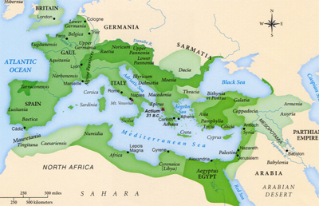
PAX ROMANA
207 years of peace and prosperity that began the Roman Empire.

Slide 6
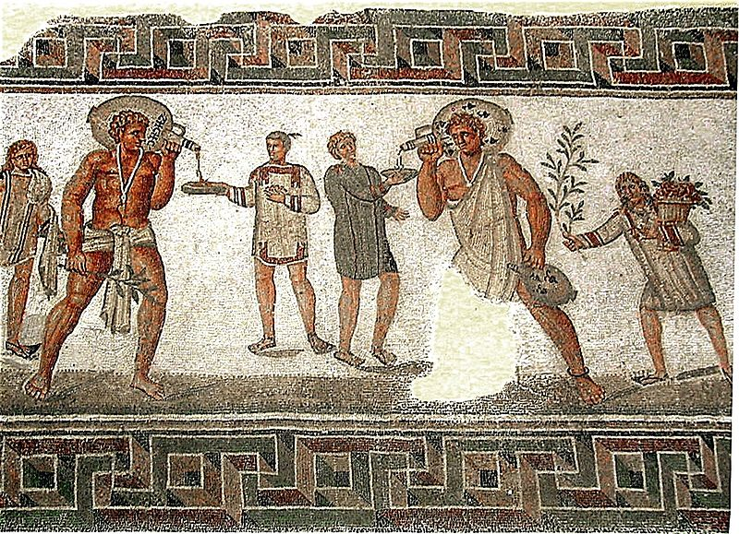
SLAVERY IN ROME
Slaves made up nearly 1/3rd of Rome’s population
They performed important tasks in cities and on farms
They were conquered people and were bought and sold as property.

Slide 7
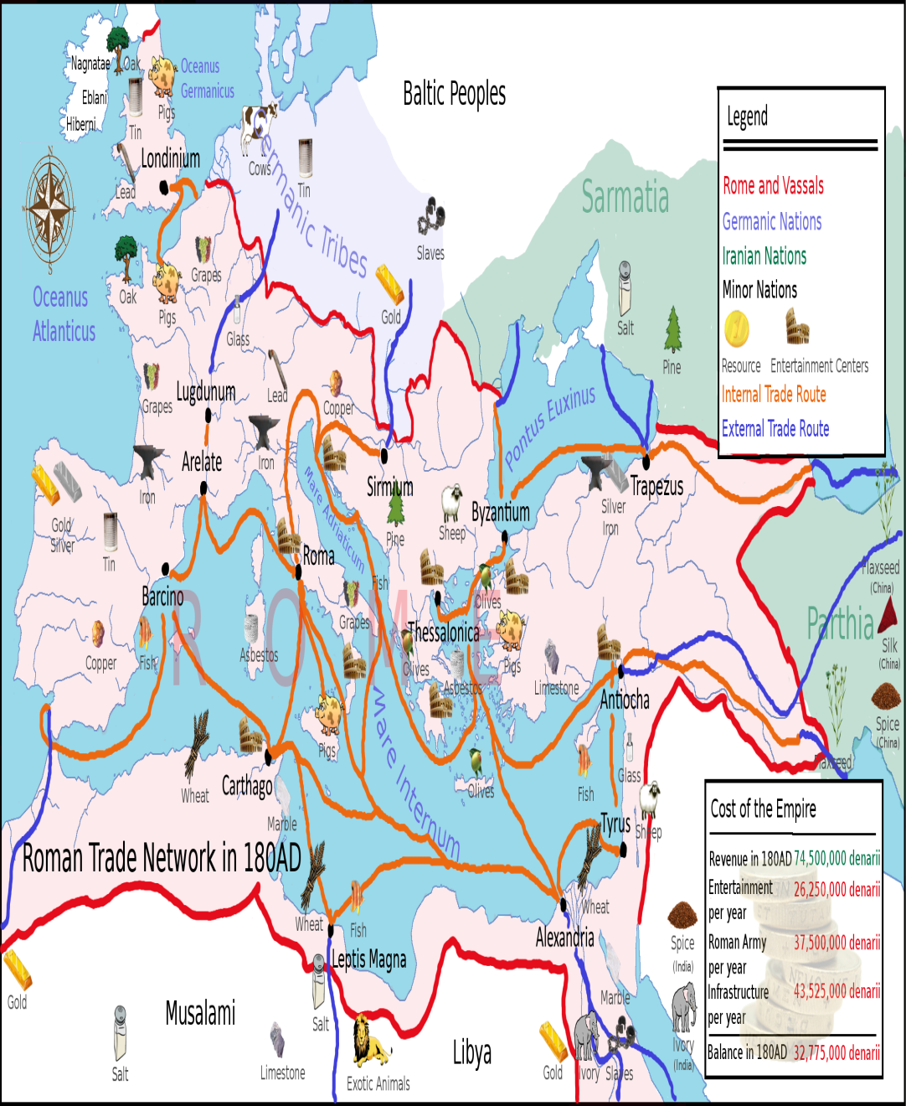
TRADE IN ROME
Rome was extremely reliant on trade both for financial success and to obtain necessary supplies
They protected trading ships and traded with places as far away as China and India

Slide 8
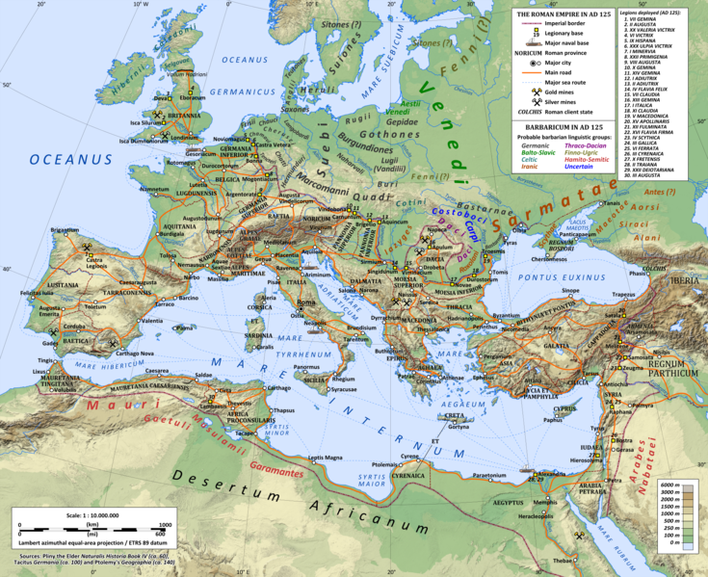
ROMAN ROAD SYSTEM BUILT
The Romans constructed a system of roads that connected the empire
Connected empire and made transportation easier and faster

Slide 9
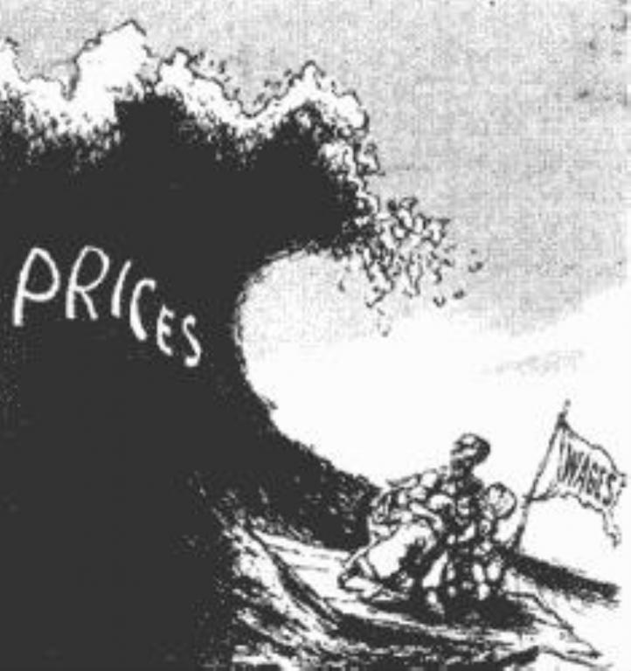
INFLATION
The value of money in Rome drastically decreased as prices rose.

Slide 10
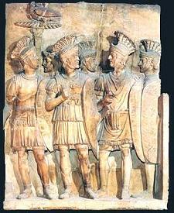
RECRUITMENT OF MERCENARIES
Roman soldiers had become less disciplined and loyal.
As a result, for defense the government hired foreign soldiers which were cheaper than Roman soldiers.

Slide 11
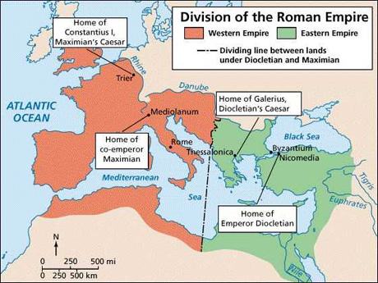
DIOCLETIAN
Ruled from 284-305
Limited personal freedoms
Claimed to be descended from Roman gods
Split empire into two halves with a system of junior and senior emperors

Slide 12
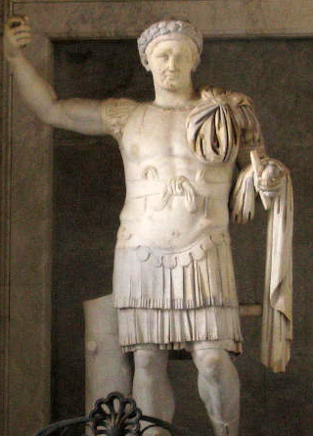
CONSTANTINE
Restarted concept of single ruler for both halves of empire
Moved capital from Rome to Byzantium (renamed as Constantinople)
Ended persecution of Christians and made it an approved religion

